Slide 1

OEM2 TASK 1: EDO: EXPLORATORY DATA ANALYSIS
Nina S. Gooden
Student ID: 009823504
Professor David Gagner

Slide 2




Research Question
Can we predict readmission based on comorbidities?
If so, what other factors contribute to readmission with comorbidities?

Slide 3



Organization Benefits
Potentially identify patients who will have high likelihood of admission
Provide centers of adjustments to lower readmission
Determine if changes need to be made to processes in order to avoid future legal action

Slide 4

Relevant Data Columns
ReAdmis, Age, VitD_levels, Doc_visits, Soft_drink, HighBlood, Stroke, Complication_risk, Overweight, Arthritis, Diabetes, Hyperlipidemia, BackPain, Anxiety, Allergic_rhinitis, Reflux_esophagitis, Asthma, and Initial_days

Slide 5
T-tests will ultimately be used to compare column data
Method
Justification
Results
All categorical variables will be transformed into 1s and 0s—for yes/no respectively —in order to run the tests
This test was the cleanest option for comparing whether or not a variable affects another. Because I’m testing against ReAdmis, this test makes the most sense.
A p-values less than statistic standard or close to 0 means there is a potential for readmission, per the ReAdmis correlation. It is important to note whether the tested variable is dependent or not.

Slide 6
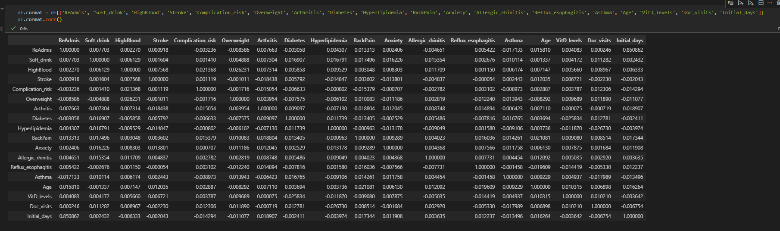
Step 1: Correlation matrix
Used to determine whether there is a positive correlation between any of the given columns, before further analysis
Output suggested correlation between Initial_days and ReAdmis

Slide 7
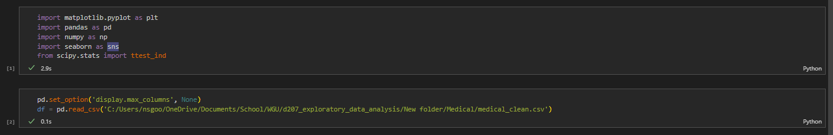
Providing the Code/Output to get Correlation Matrix
Importing the necessary libraries.
Converting the csv file into a dataframe.

Slide 8
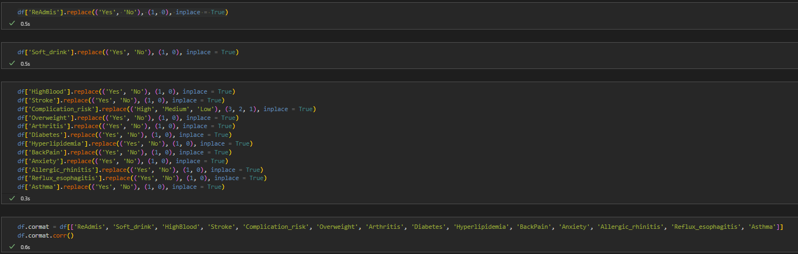
Providing the Code/Output to get Correlation Matrix
Converting categorical data into numeric measures so that it can be utilized and compared in the correlation matrix
Converting the csv file into a dataframe.

Slide 9
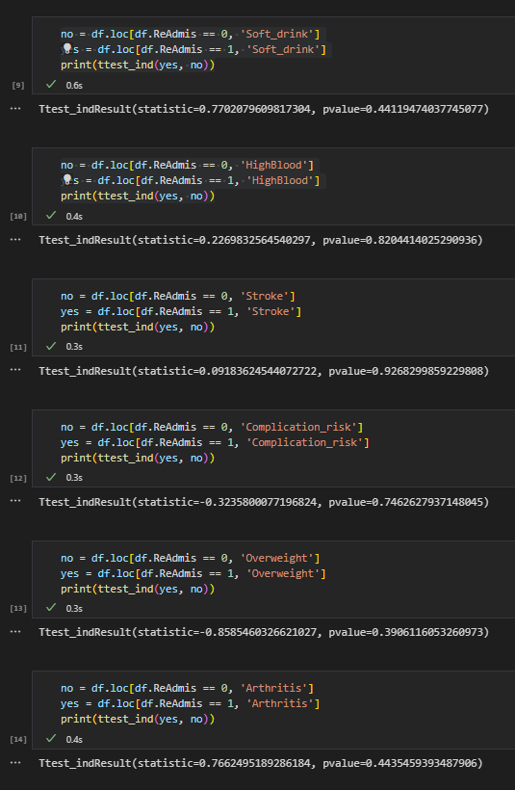
Step 2: T-test Outputs, Part 1
The Python code for running a T-test is really easy to read. I also utilize Jupyter Notebook in my environment, so I didn’t have to run them all at once.
Dependency
No variables were dependent in this first group.
Results
Arthritis shows the potential for readmission. Interestingly enough, Overweight does not. Since this is frequently a concern for medical professionals, I want to pull this variable for additional tests as well.

Slide 10
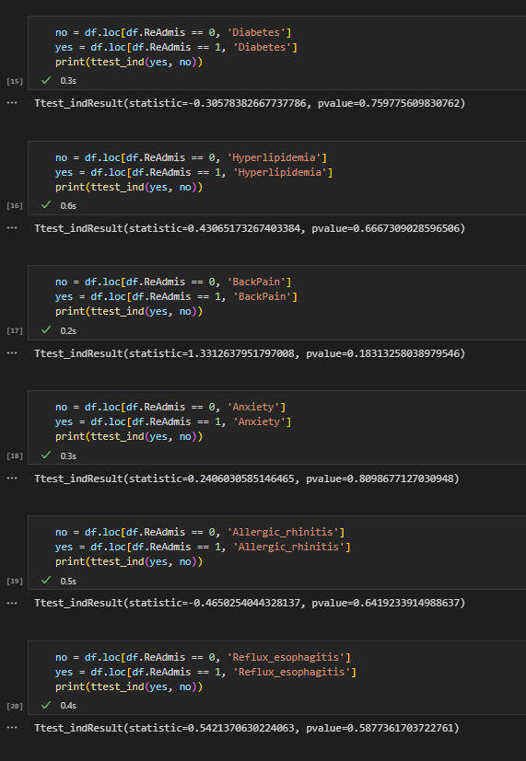
T-test Outputs, Part 2
The Python code for running a T-test is really easy to read. I also utilize Jupyter Notebook in my environment, so I didn’t have to run them all at once.
Dependency
No variables were dependent in this second group.
Results
BackPain shows the potential for readmission

Slide 11
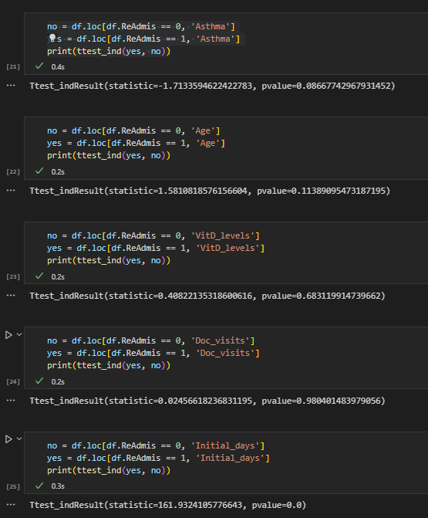
T-test Outputs, Part 3
The Python code for running a T-test is really easy to read. I also utilize Jupyter Notebook in my environment, so I didn’t have to run them all at once.
Dependency
Asthma, Age, and Doc_visits, and Initial_days were all Dependent variables.
Results
Asthma shows the potential for readmission, as does Age and Initial_days.

Slide 12
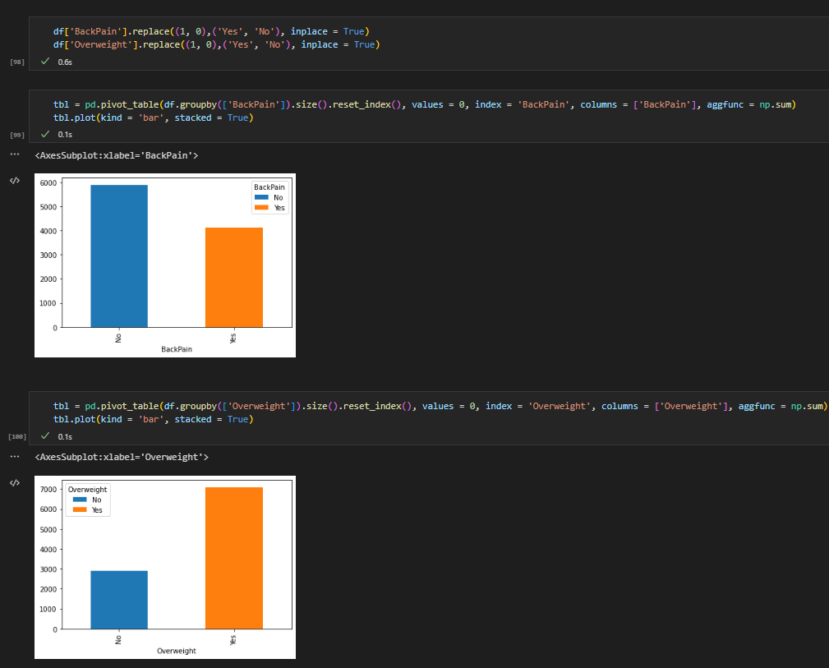
Univariate Analysis, Part 1
Categorical Variables
BackPain, Overweight
Reasoning
BackPain showed the potential for readmission correlation in the T-tests.
Being overweight is a hot-button issue in the medical community. I wanted to check this column to see if there was merit for that concern.

Slide 13
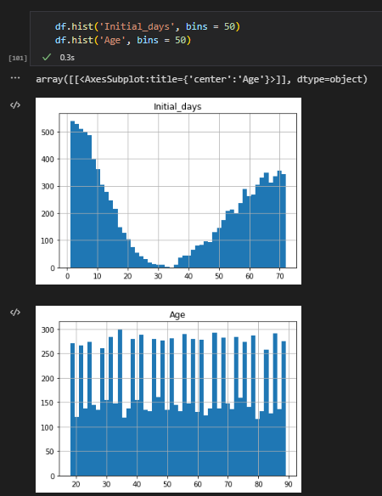
Univariate Analysis, Part 2
Continuous Variables
Initial_days, and Age
Reasoning
Initial_days, and Age showed the potential for readmission correlation in the T-tests.

Slide 14
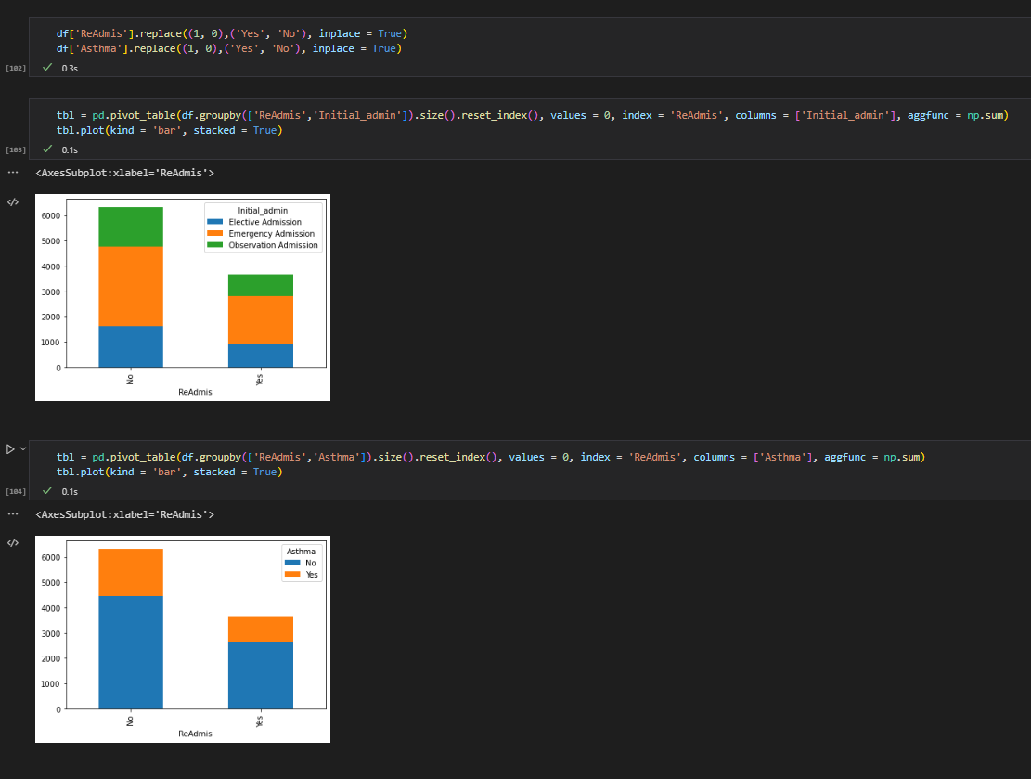
Bivariate Analysis, Part 1
Categorical Variables
Initial_admin, Asthma
Reasoning
Initial_admin and Asthma showed the potential for readmission correlation in the T-tests. In order to get an accurate view of these variables, I needed to look at them broken down further.

Slide 15
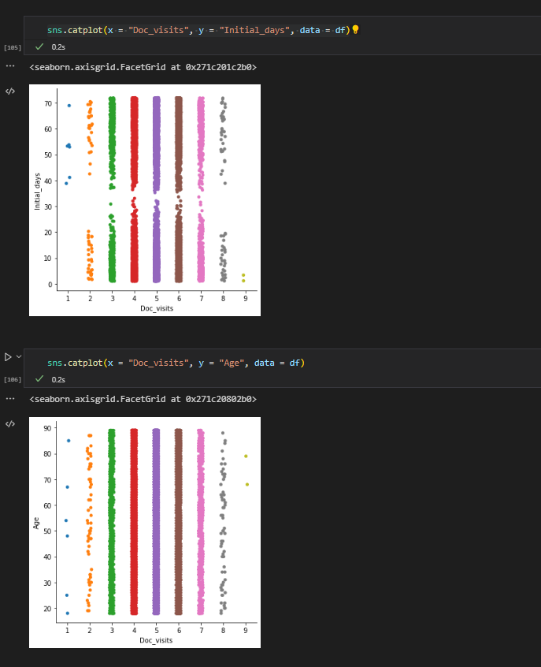
Bivariate Analysis, Part 2
Continuous Variables
Initial_days, Age
Reasoning
Initial_days and Age showed the potential for readmission correlation in the T-tests. I used Doc_visits as a comp because the spread for the secondary variable was easy to categorize visually.

Slide 16
Summary of Implications
1. Results
2. Limitations
3. Recommendations
T-tests identifies variables that had a potential for correlation with readmission.
Patients with higher age and those with asthma were found to have significant probabilities of being readmitted.
Duration of Initial_days was also found to have the potential for correlation.
With and all statistical evaluations, it is vital that we remember that correlation and causation are not one and the same.
Data evaluated is from a single industry source, with set resources and may not apply to all medical institutions.
Varying degrees of correlation were noted and should be further examined for in-depth analysis.
Reduce number of days patients are held after being initially admitted to the hospital.
Spend additional resources on patients over a certain threshold of age in order to decrease the likelihood for readmittance—reporting and observing this trend may be vital to avoiding lawsuits.
Provide patients with asthma additional resources to offset and note any specific challenges.

Slide 17


Sources for Third-Party Code
Seaborn.histplot#. seaborn.histplot - seaborn 0.12.0 documentation. (n.d.). Retrieved September 30, 2022, from https://seaborn.pydata.org/generated/seaborn.histplot.html
https://stackoverflow.com/questions/72009138/pandas-dataframe-label-columns-encoding
pandas.DataFrame.sort_values — pandas 1.5.0 documentation. (n.d.). Retrieved September 30, 2022, from https://pandas.pydata.org/docs/reference/api/pandas.DataFrame.sort_values.html
GeeksforGeeks. (2022, September 28). Python program to convert a list to string. Retrieved September 30, 2022, from https://www.geeksforgeeks.org/python-program-to-convert-a-list-to-string/?ref=leftbar-rightbar

Slide 18
References
Madhavan, A. (2022, September 16). Correlation vs Causation: Understand the Difference for Your Product. Amplitude. Retrieved September 30, 2022, from https://amplitude.com/blog/causation-correlation

